Slide 1





ORGANIZING COMMITTEE
Partnership Opportunity

Slide 2
INVITATION LETTER
Dear Distinguished Partner,
On behalf of AIESEC in VIETNAM, I am reaching out to you regarding a request for sponsorship in YouthSpeak Forum 2017 in the middle of October, 2017. To raise youth’s awareness of social issues and inspire them to take action for activating “17 Sustainable Development Goals”, AIESEC in Vietnam together with VCCI - Vietnam Chamber of Commerce and Industry and Ho Chi Minh Communist Youth Union of Hanoi decide to collaborate to organize “YouthSpeak Forum 2017”. YouthSpeak Forum is a wonderful opportunity for your company to gain valuable exposure within the community while supporting a worthy cause, demonstrate company’s vision, access to top talents from key universities, and emphasize the CSR positioning.
YouthSpeak held for the first time in Hanoi promises to continue the success of YouthSpeak held in March, 2017 in Ho Chi Minh city. To get more information about our YouthSpeak in HCM, please kindly Click VTV24 News and YouthSpeak Spring 2017 Report .
YouthSpeak Forum is a premiere event that brings together both
young and senior leaders to form a diverse cross-sector and multi-
generational space for inspiring conversations around pressing global issues. The forum aims to create an environment where people from diverse backgrounds can cross-pollinate ideas, share insights and gain new perspectives to create actionable outcomes to push the world forward.
Your sponsorship will help assure the success of YouthSpeak Forum 2017. Enclosed please find more information on our event and its sponsorship levels. Please do not hesitate to contact me with any questions or concerns. I look forward to speaking with you at your earliest convenience.
Sincerely,
Organizing Committee of YouthSpeak Fall 2017

Slide 3
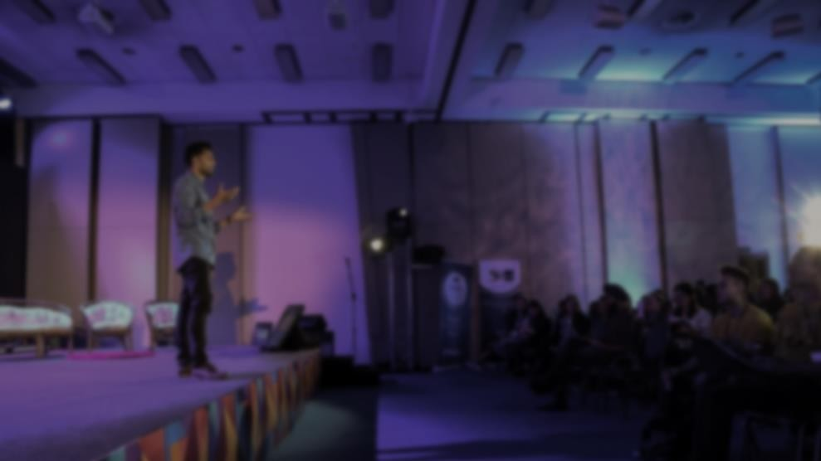


About us
Present in 126 countries and territories, is a global youth-led organization striving to achieve “Peace and fulfillment of humankind’s potential” by activating leadership qualities in youth through learning from practical experiences in challenging environments. Together with partner organizations, AIESEC facilitates a network of cross-cultural exchanges in the form of volunteering experiences and professional internships.

Slide 4
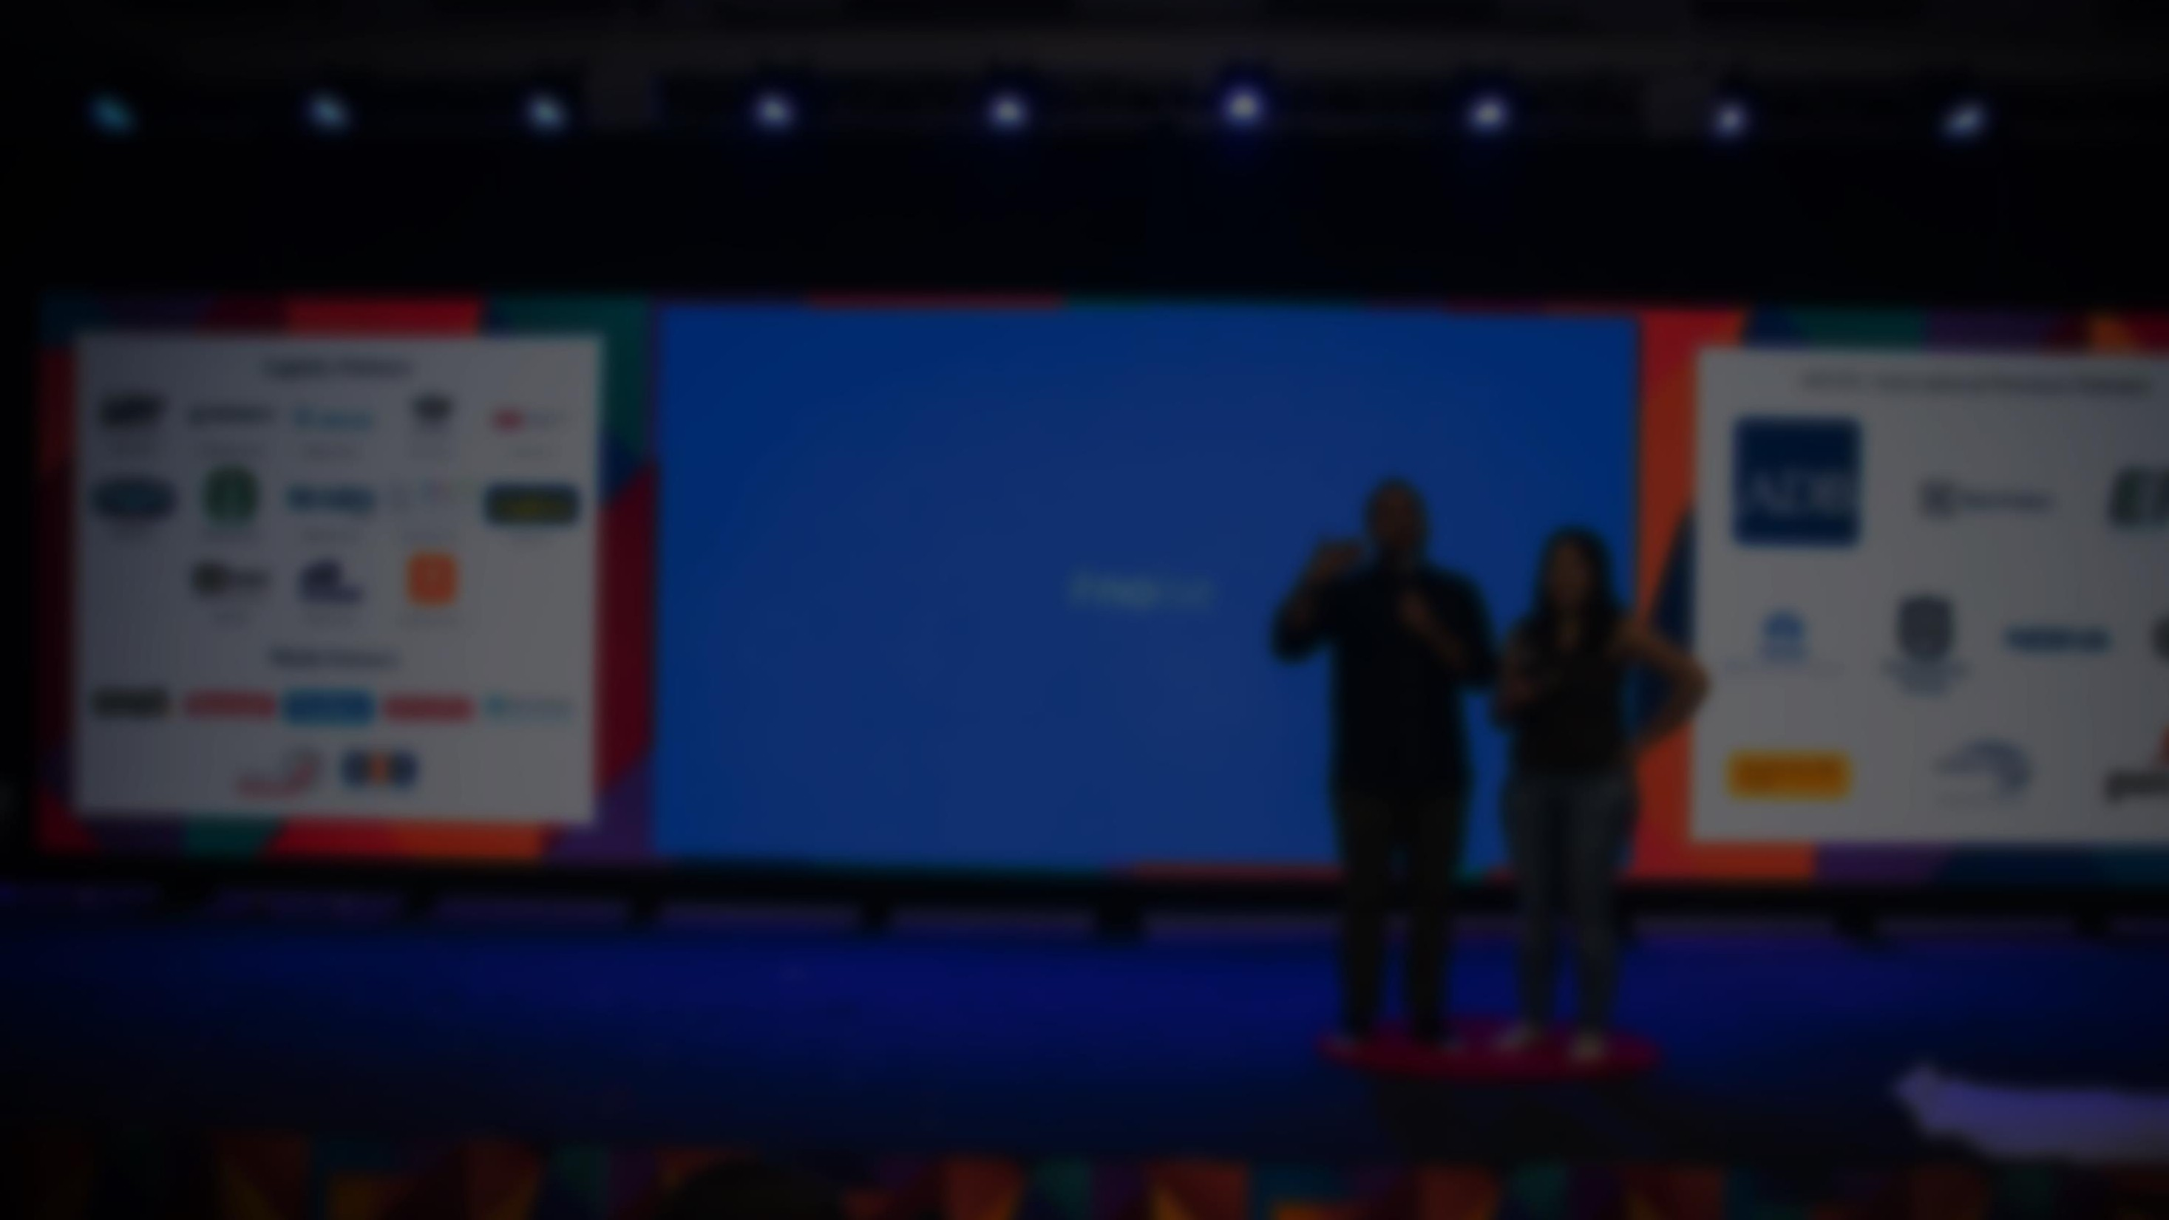


About us
About us
About us
During our journey of developing leadership potential for Vietnamese youth, we are proud to say that we
are able to achieve some major successes expressed in the following numbers:
10 years
in official operations
700+
current members
1000+
alumni
150+
organizations in partnership
1000+
exchanges delivered in 2014

Slide 5

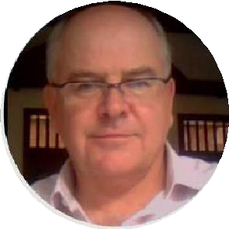
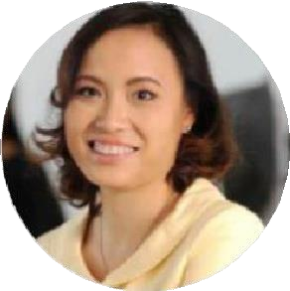
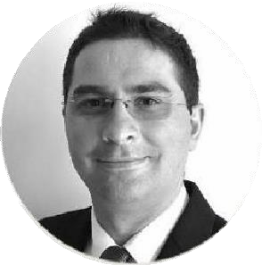
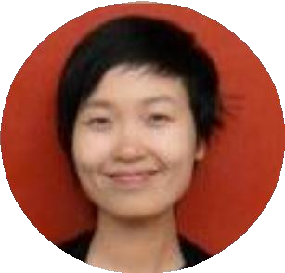
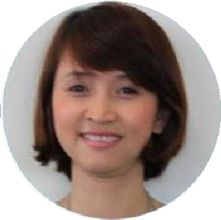
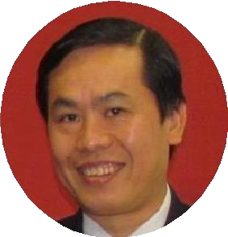
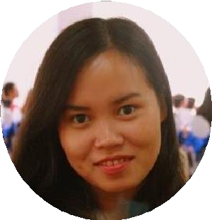
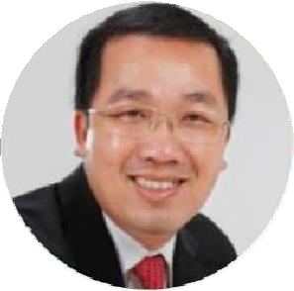
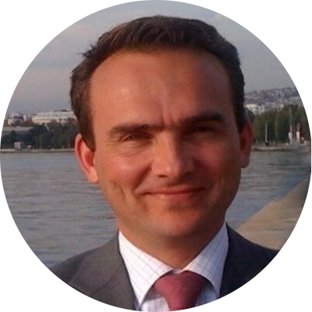
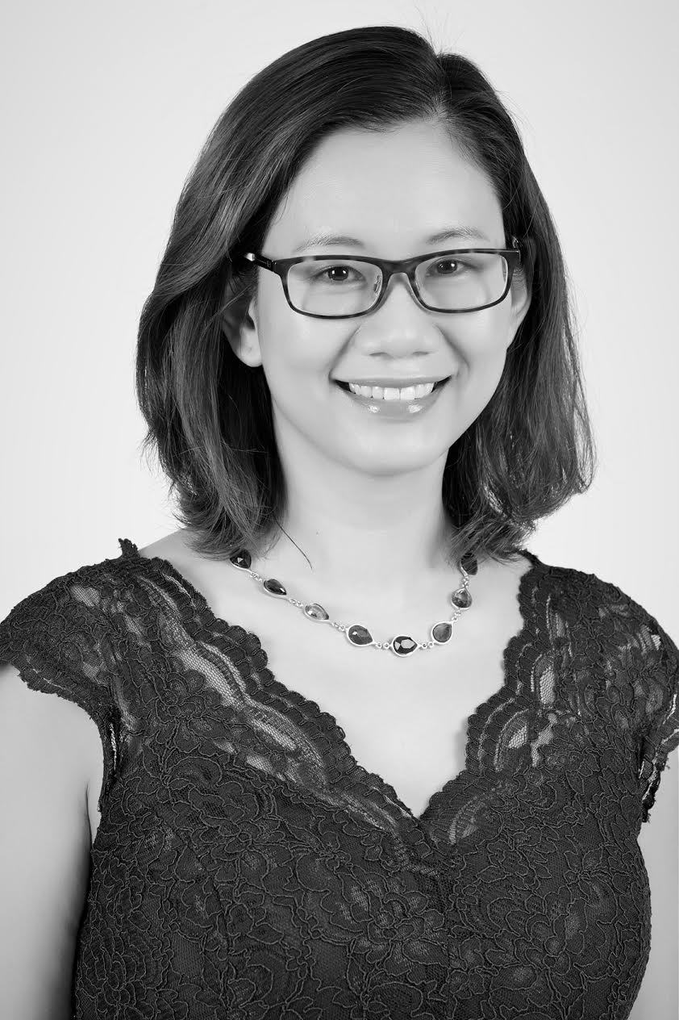
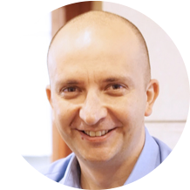
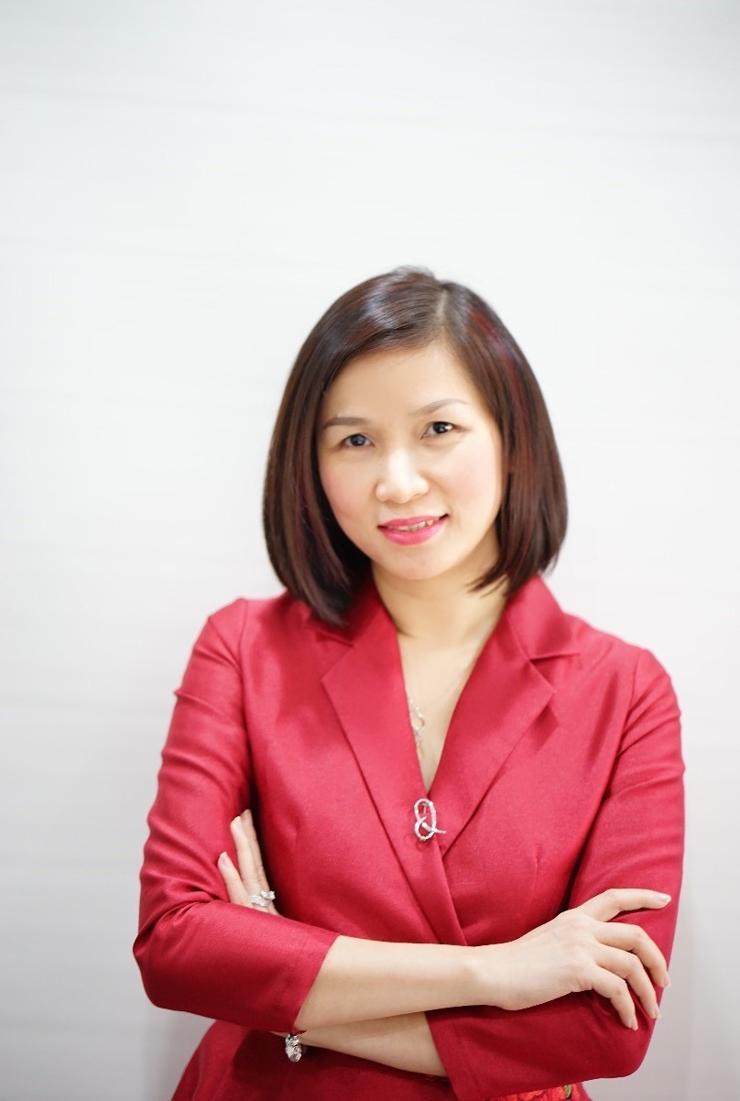
AIESEC in VIETNAM | NATIONAL ADVISORY BOARD
Tom Bowen
General Manager
Vietnam Golf Distribution.
Former CEO Standard Chartered Bank Vietnam.
AIESEC Hanoi & AIESEC Danang BoA
Trinh Tieu Yen
General Director
TalentNet Corporation
Attila Vadja
General Director
City Clinic
AIESEC International 2004-2005.
Ha Cao
Country Director
Education First
Nguyen Tam Trang
VP Human Resources
Unilever Vietnam
Le Hong Phuc
Chief Human Resources Officer
Novaland Group
Vu Anh Tho
COO Vietnam Human Resources
President AIESEC in Vietnam 2012 - 2013
Ton That Anh Vu
VP Human Resources
HSBC Vietnam
Arnoud van den Berg
Managing Director FrieslandCampina Vietnam
Former President of AIESEC in the Netherlands
Nguyen Huong Quynh
Managing Director
Nielsen Vietnam
Csaba Bundik
Vice Chairman at Central and Eastern EUROCHAM in Vietnam
Huynh Thi Xuan Lien
CMO - Suntory Pepsico
Vietnam Beverage

Slide 6

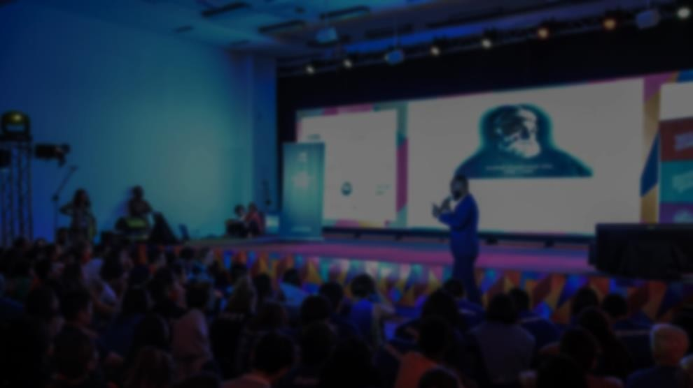
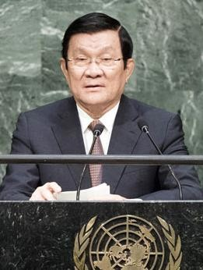
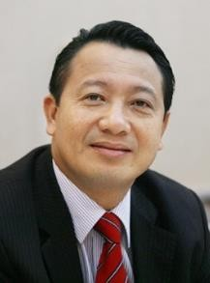
About SDGs & Youth
About us
About us
The Sustainable Development Goals (SDGs), officially known as Transforming our world: the 2030 Agenda for Sustainable Development is a set of 17 aspirational "Global Goals" with 169 targets between them, which has been approved by 193 countries’ leaders on 25th September, 2015.
Better Brand Positioning
Attract employees and investors High Productivity & Cost Saving
Waste Reduction
Why SDGs?
Market Opportunity/ New Revenues More chances for multi-stakeholder collaboration
License to operate
“Vietnam wholeheartedly supports the 2030 Agenda and pledges to do our level best to ensure its successful implementation.”
“Making SDGs come true is not only a duty, but also a great opportunity for businesses.”
Mr. Quang Vinh Nguyen– Deputy General Secretary of VCCI
Mr. Tan Sang Truong – Former President of
Vietnam

Slide 7
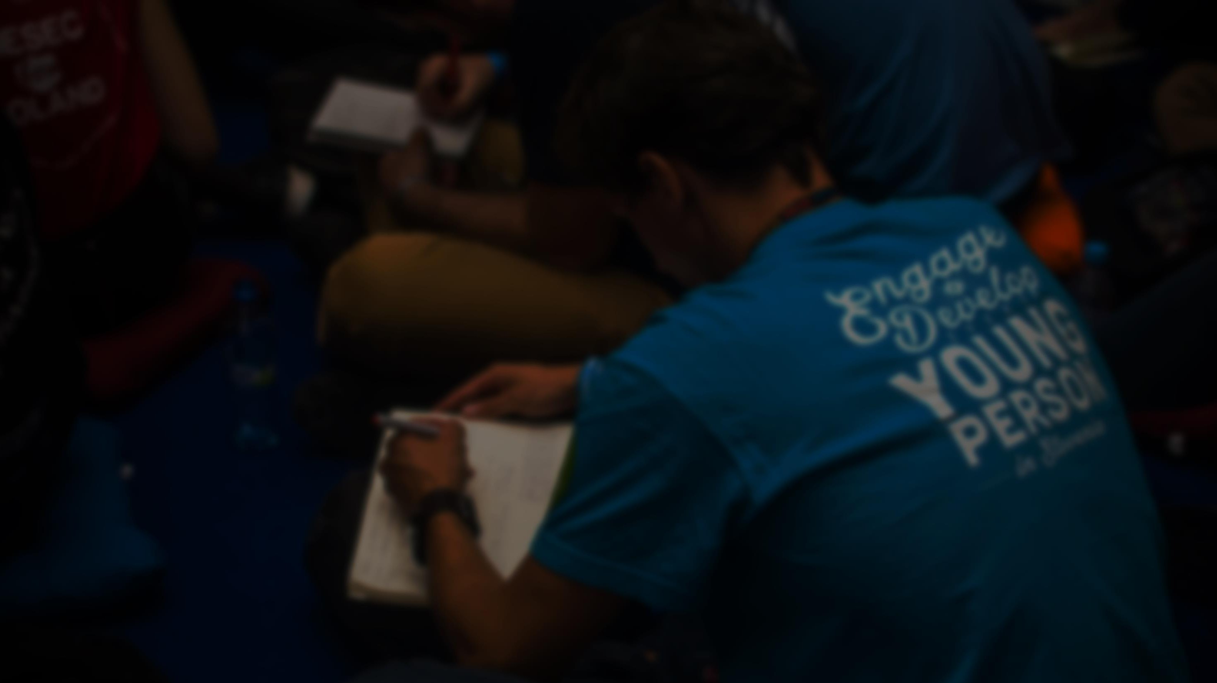
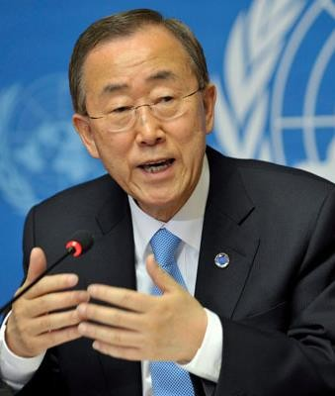
About SDGs & Youth
About us
About us
Youth, according to United Nations, which has the population of 1.8 billion people, plays a critically important
role in SDGs implementation and society because we are:
Why Youth?
Critical Thinkers
We have the capacity to identify & challenge current power structure, biases, contradictions
Innovators
Youth best understands the problems and can offer new ideas & alternative solutions
Communicators
Young people can communicate the 2030 agenda to their peers & communities in different levels
Leaders
Young people, when empowered and developed, can drive changes in their countries, communities
Change Makers
We have the power to act and mobilize the others
“When we invest in youth, they can contribute to new markets, decent jobs, fair trade, sustainable housing, sustainable transport
and tourism, and more opportunities that benefit the planet and people.”
Mr. Ban Ki Moon – Secretary-General of the United
Nations

Slide 8


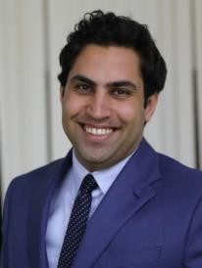






About Y4GG
A global campaign powered by AIESEC to
mobilize young people for the achievement of the Sustainable Development Goals
“Youth leadership and ownership is critical for the successful delivery of the Sustainable Development Goals. United Nations
had long recognized the efforts of AIESEC in promoting peace and development through professional and cultural exchange.”
Mr. Ahmad Alhendawi – Secretary-General's Envoy on Youth
Y4GG’s Global Partners

Slide 9
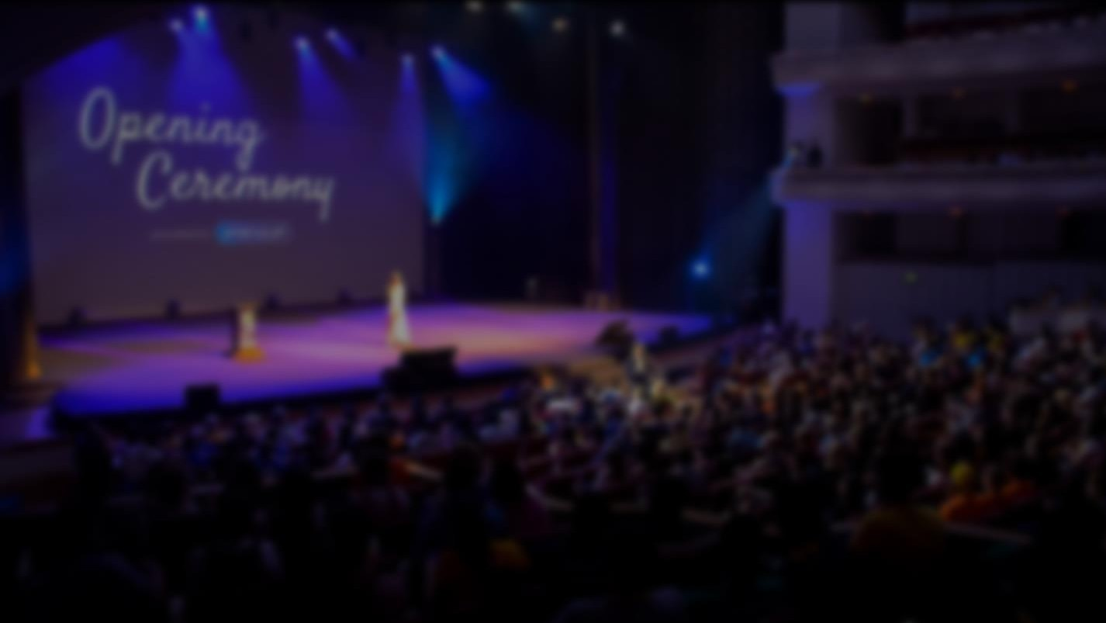




About YouthSpeak Fall 2017
raising awareness
,
inspiring
empower
By
on the current issues
youth engagement &
them to generate ideas as well as implementing actions in co-operation with other stakeholders, we envision a generation who determines
towards Sustainable Development Goals (SDGs).
&
160,000+
youth engagement
197
countries & territories

Slide 10
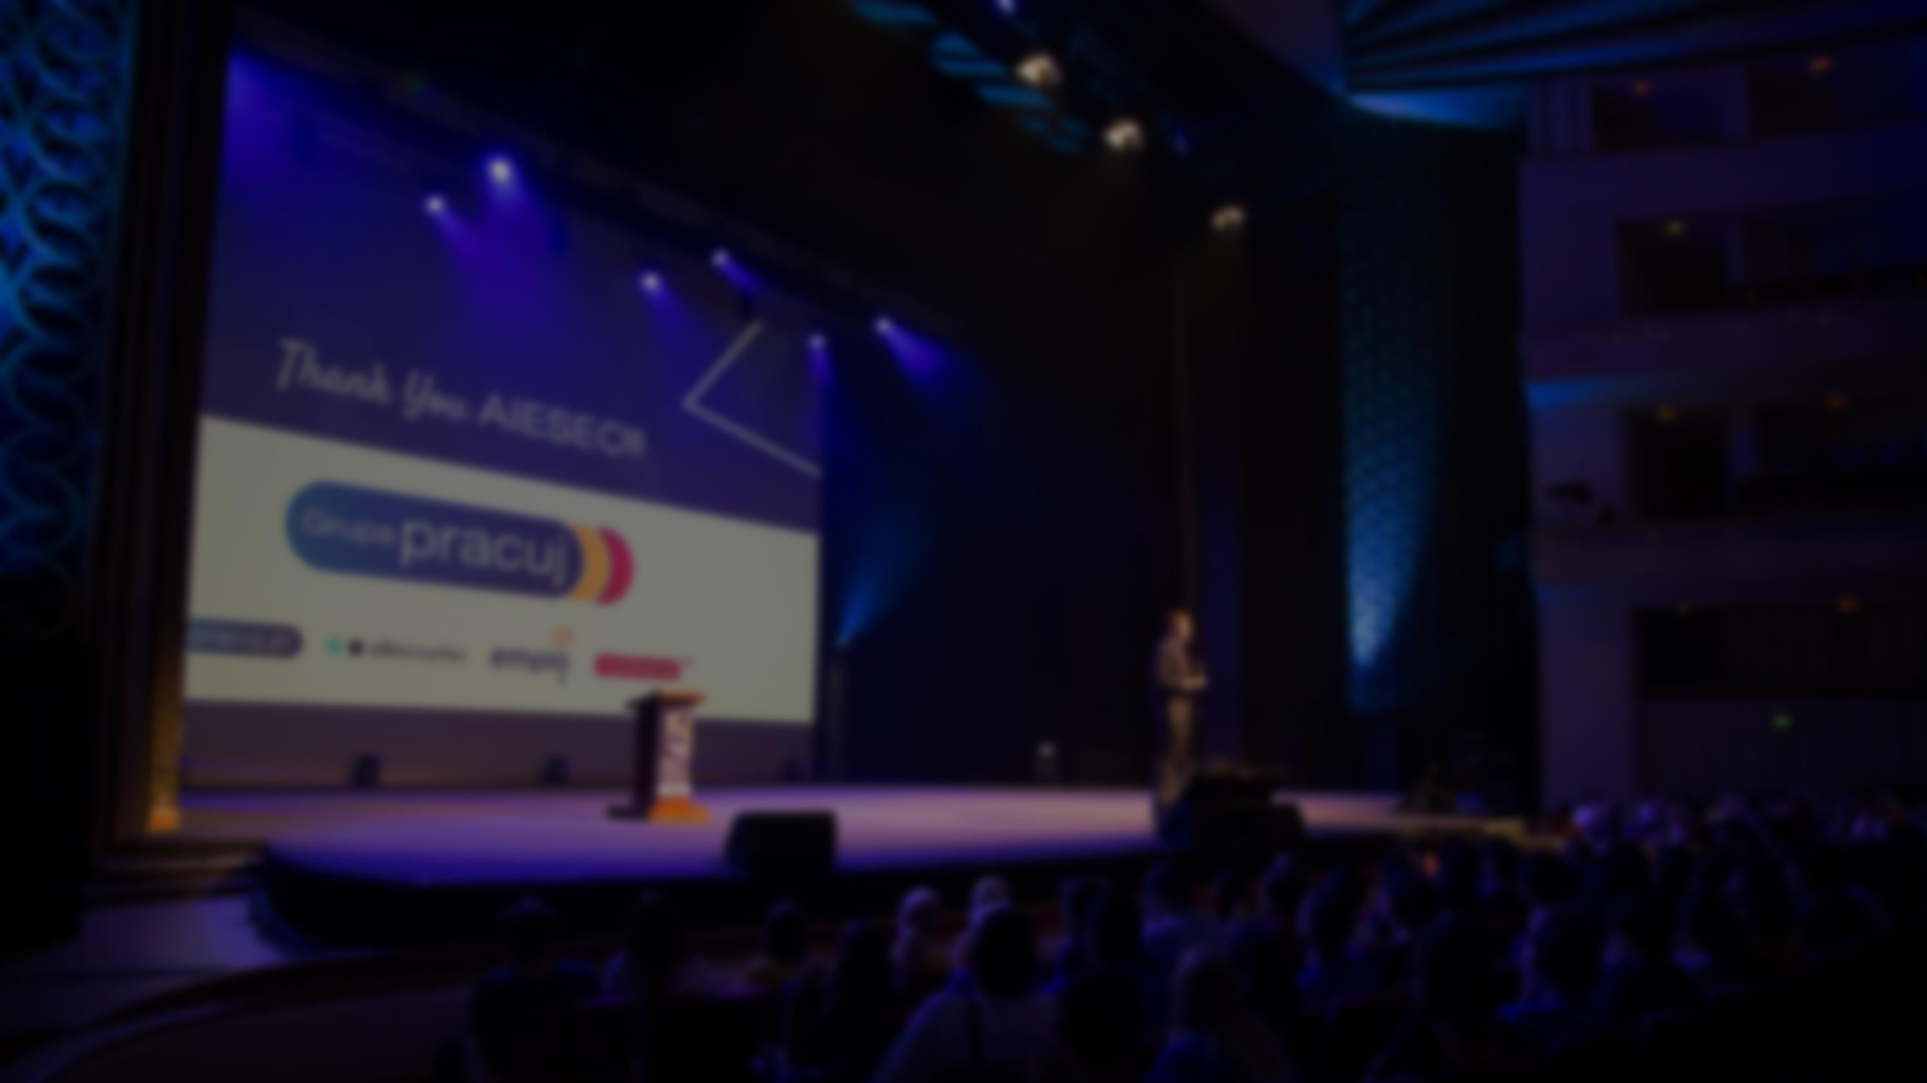



About YouthSpeak Fall 2017
Generation of
“Never stop innovating yourself to reinvent the world”
To put trust in his/her capacity to change
To create new ideas or develop current ones for better outcomes
To commit until the very end regardless of hardship

Slide 11
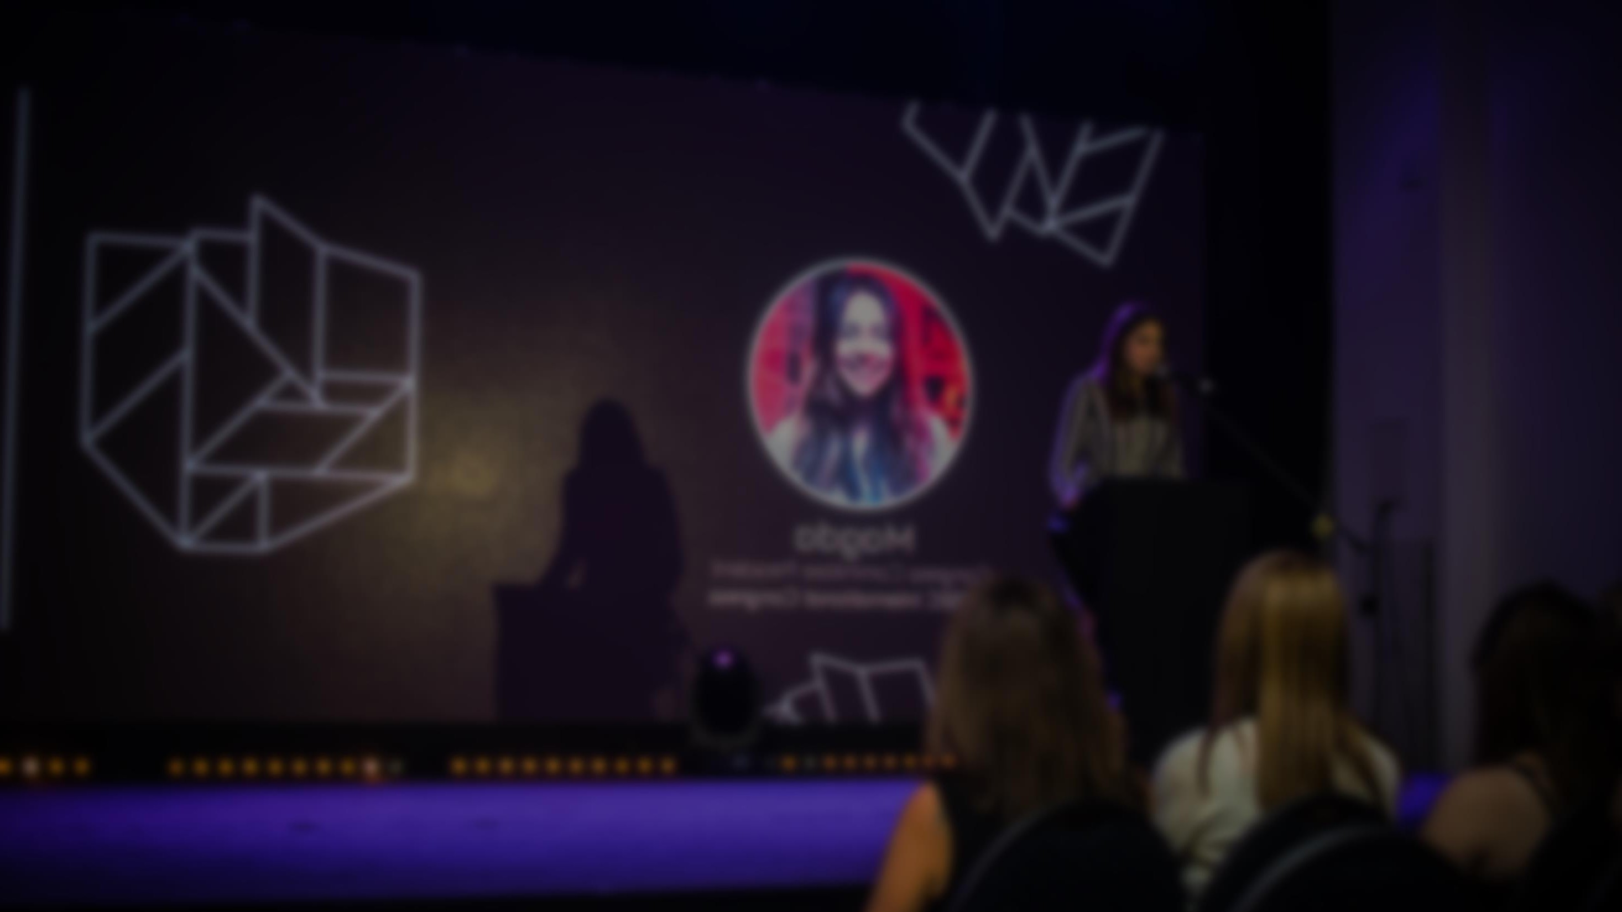





About YouthSpeak Fall 2017
Reach
Aware
Understand
Act
SDGs
Project
1000+
physical attendance
2,300,000 +
youth reached
20+
business partners
20+
media units

Slide 12
About YouthSpeak Fall 2017
8/2017 – 9/2017
University Tour
A series of workshops expected to be organized at top universities to raise youth awareness & equip knowledge about the importance of SDGs. These events also give students spaces to enhance their solution-oriented mindset to solve social issues and for their further career development
What
?
How
?
Sharing
Presentation
Lab Spaces
Debating
Networking Space
50–80 Selective students (per school) from 6 key universities including: Foreign Trade University, National Economic University, Hanoi University of Science and Technology, RMIT University Vietnam’s Hanoi City, University of Languages and International Studies, Hanoi University
Who? (expected)

Slide 13

About YouthSpeak Fall 2017
22-23/10/2017
YouthSpeak Forum
YouthSpeak Forum 2017 is a 2-day event that brings together young leaders, business, government and NGO representatives to form a diverse cross-sector and multigenerational space for inspiring conversations - to create an environment for new perspectives – to put forward actionable outcomes and projects for the achievement of the Sustainable Development Goals. The main part of the event is Forum (480 top talents and 20+ partners)
What?
How?
Speeches
Fish Bowl
SDGS Workshops
Case Competition
Career Workshops
Who? (For Forum Delegates only)
10%
30%
20%
From Top Universities (FTU, NEU, HANU, ULIS)
Active participation in extracurricular activities
Good academic performance with high GPA (> 7.0)
Have career objectives
Interested in social issues and relating activities
Looking for a place to contribute their ideas networking with other talents and gain more knowledge
70%
70%
Economic Major Technical Major Social Major
3rd, 4th year 1st, 2nd year

Slide 14
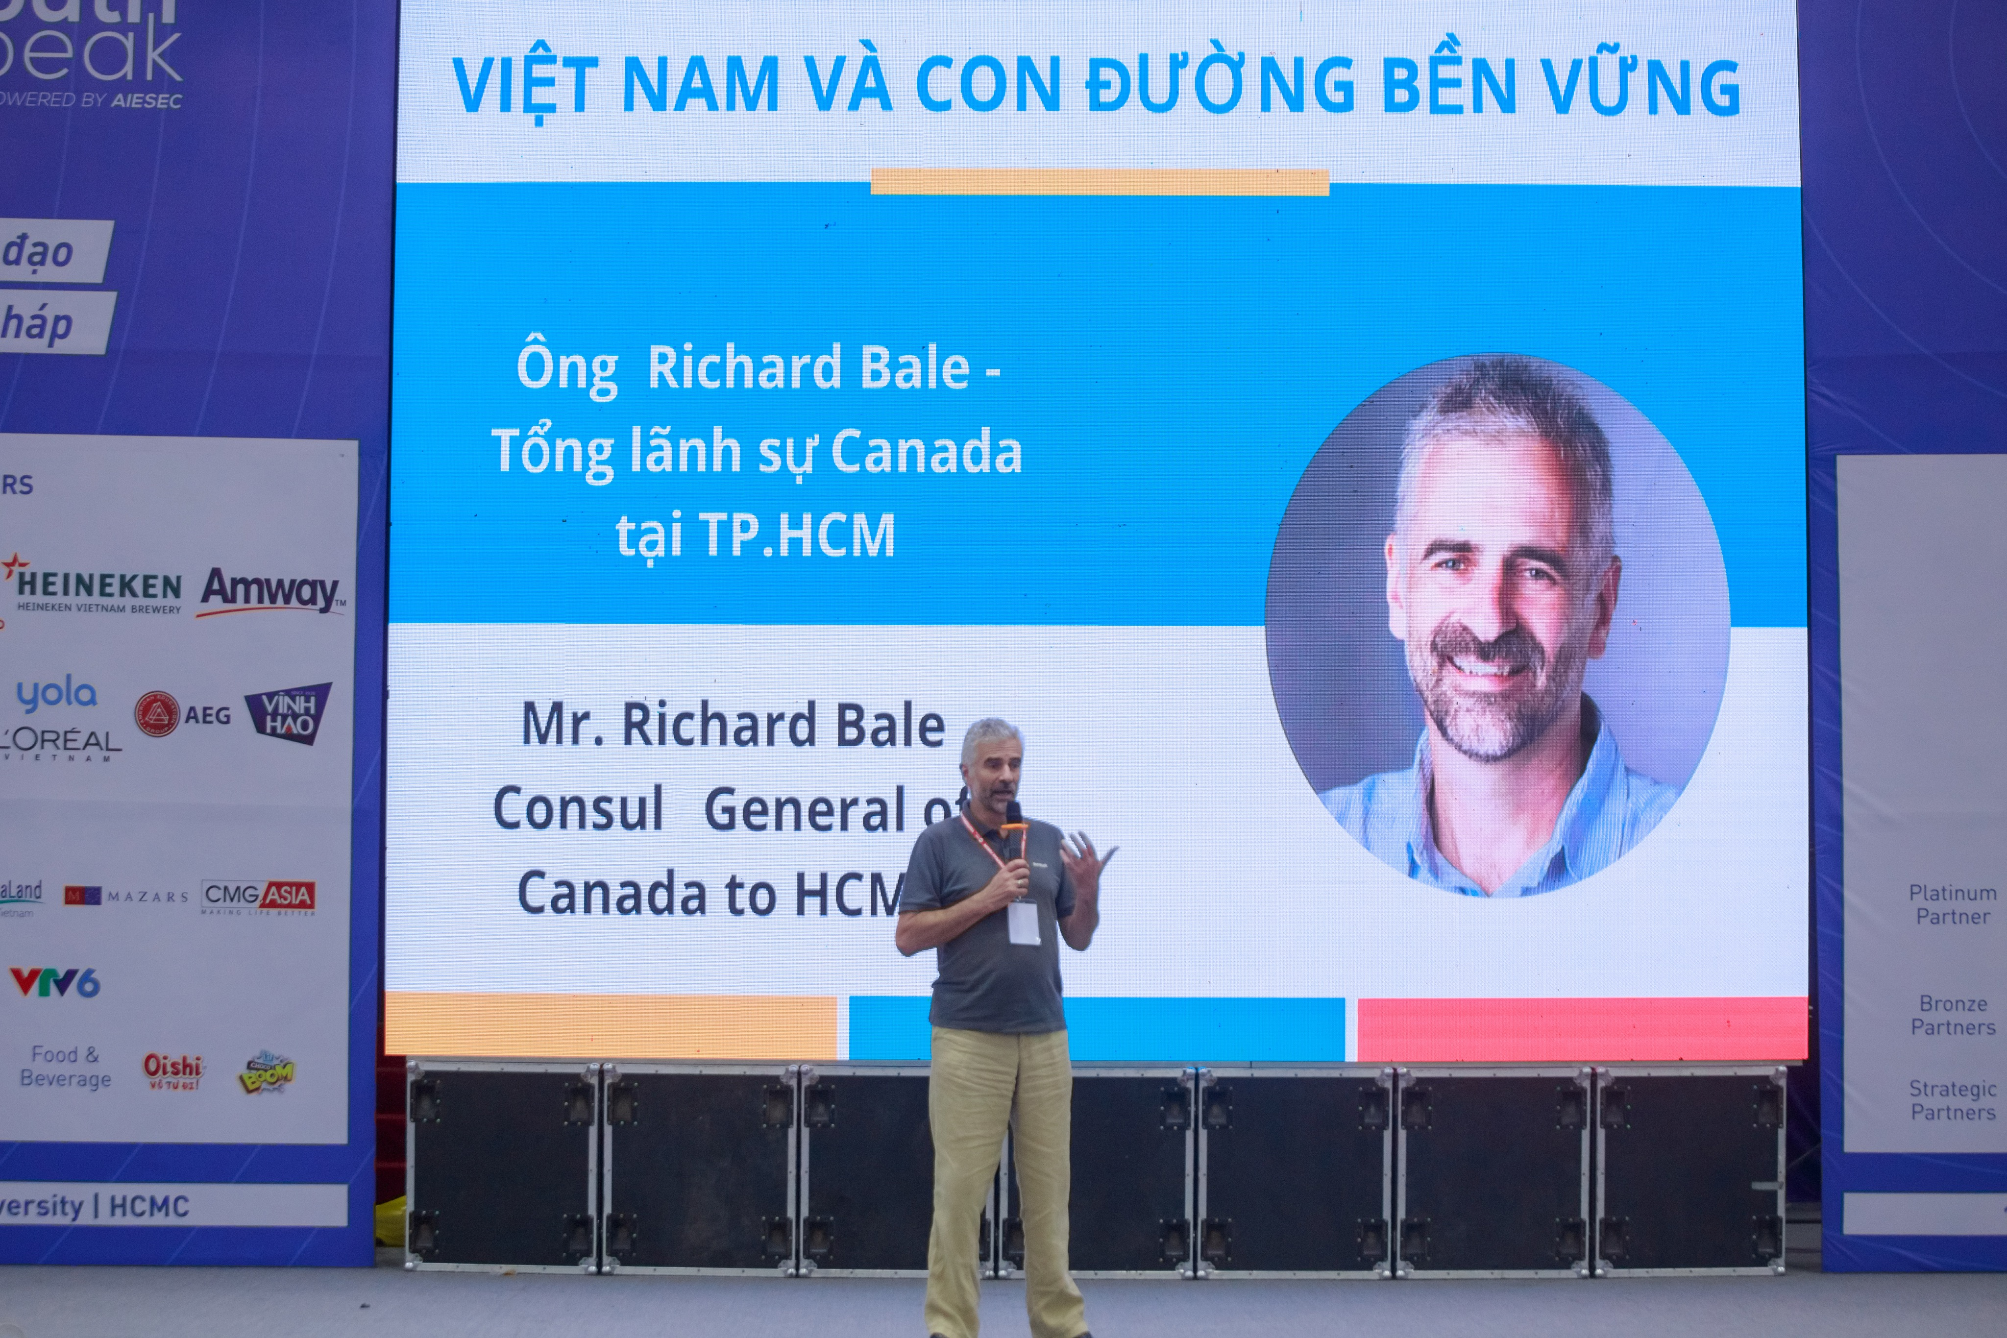
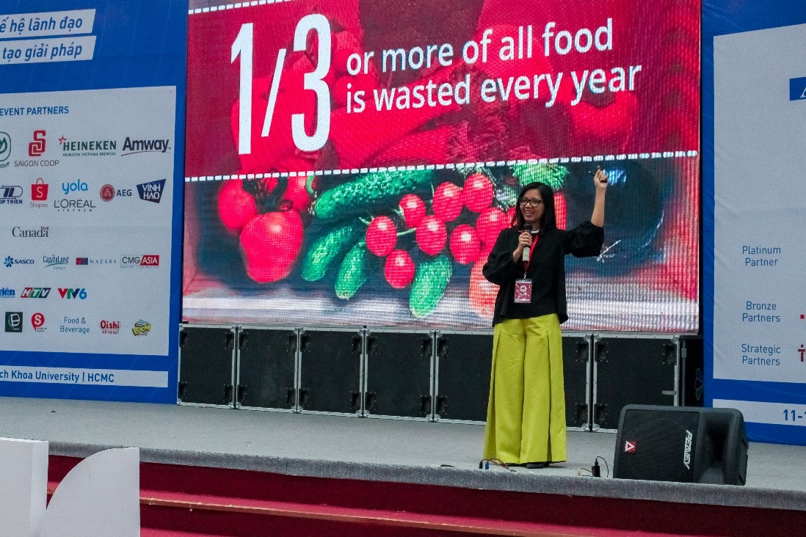
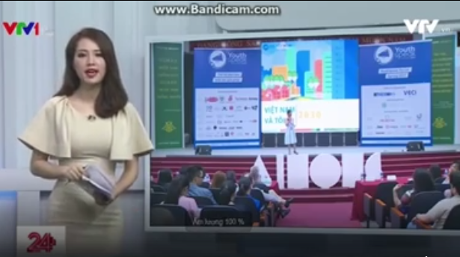
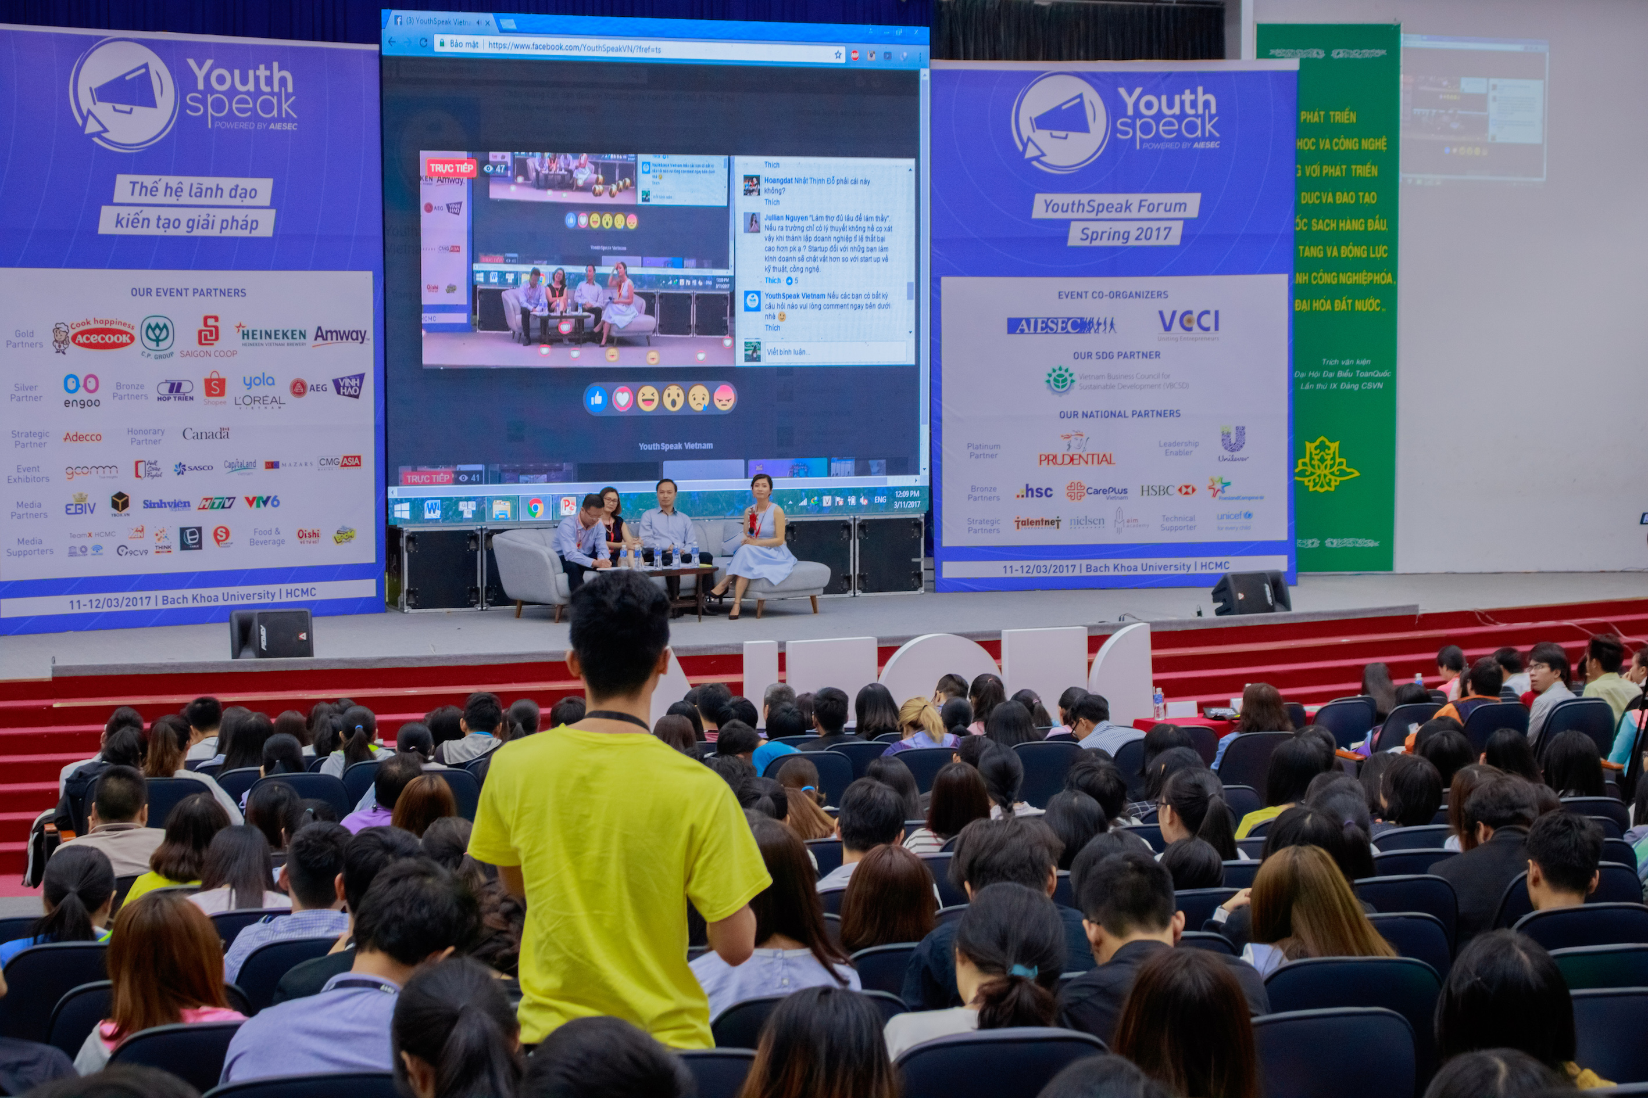

Current National Partners
YouthSpeak Spring 2017
Notes:
Move the blue sign.

